Slide 1

PRIVATE INSTITUTION
HIGHER EDUCATION
"INSTITUTE OF THE STATE ADMINISTRATION"
License, validity period – unlimited
State accreditation, validity period – unlimited
Founded 1994

Slide 2
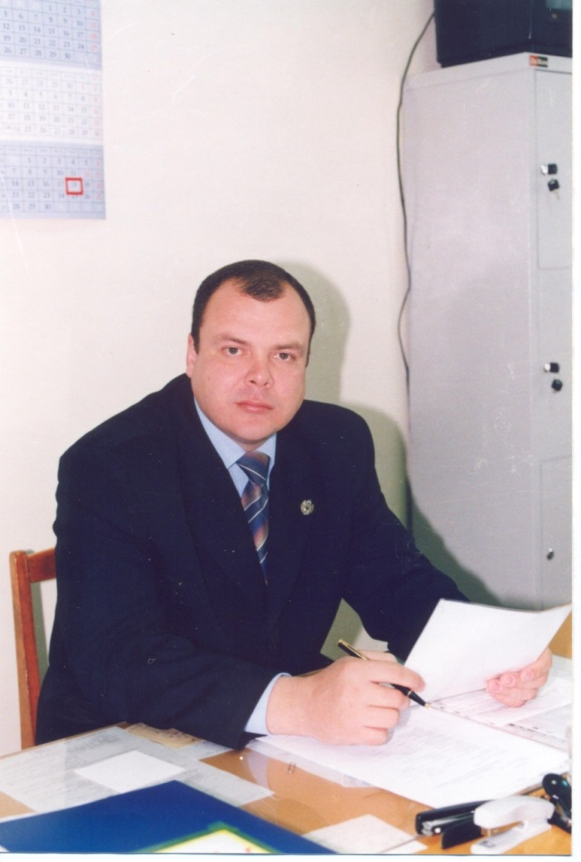
Dear future student, the best among this year's applicants!
We already see you in the walls of one of the most prestigious universities in the country,
ISA – Institute of the State Administration!!!
Our institute is 30 years old. It annually graduates more than 1,500 highly qualified specialists working in state and municipal institutions, in various organizations and business sectors.
FUNDAMENTAL EDUCATION IS A GREAT START TO YOUR PROFESSIONAL JOURNEY

Slide 3
DIRECTIONS AND PROFILES OF TRAINING
ECONOMICS bachelor degree – profiles: FINANCE AND CREDIT; FINANCE, CREDIT AND DIGITAL SERVICES; ACCOUNTING AND AUDIT; AUDIT, ANALYSIS AND ACCOUNTING IN DIGITAL ECONOMY
ECONOMICS Master's program – profile ECONOMICS AND FOREIGN ECONOMIC ACTIVITY
MANAGEMENT bachelor degree – profile ORGANIZATION MANAGEMENT
STATE AND MUNICIPAL MANAGEMENT bachelor degree – profiles: STATE AND MUNICIPAL MANAGEMENT IN THE SOCIAL SPHERE; MANAGEMENT IN THE FIELD OF INTERREGIONAL AND INTERSTATE RELATIONS
BUSINESS INFORMATICS bachelor degree – profile INFORMATION TECHNOLOGY IN ENTERPRISE MANAGEMENT
JURISPRUDENCE bachelor degree – profiles: CIVIL LAW, CRIMINAL LAW
JURISPRUDENCE Master's program – profiles: CIVIL LAW, FAMILY LAW, PRIVATE INTERNATIONAL LAW; THEORY AND PRACTICE OF APPLICATION OF CRIMINAL LEGISLATION
PEDAGOGICAL EDUCATION Bachelor degree – profile LEGAL EDUCATION
PSYCHOLOGY Bachelor degree – profile PSYCHOLOGICAL COUNSELING
PSYCHOLOGICAL AND PEDAGOGICAL EDUCATION bachelor degree - profiles PSYCHOLOGY AND PEDAGOGY OF PRIMARY EDUCATION; PSYCHOLOGY AND PEDAGOGY OF PRESCHOOL EDUCATION; PSYCHOLOGY AND SOCIAL PEDAGOGY
SPECIAL (DEFECTOLOGICAL) EDUCATION bachelor degree – profile Speech Therapy

Slide 4

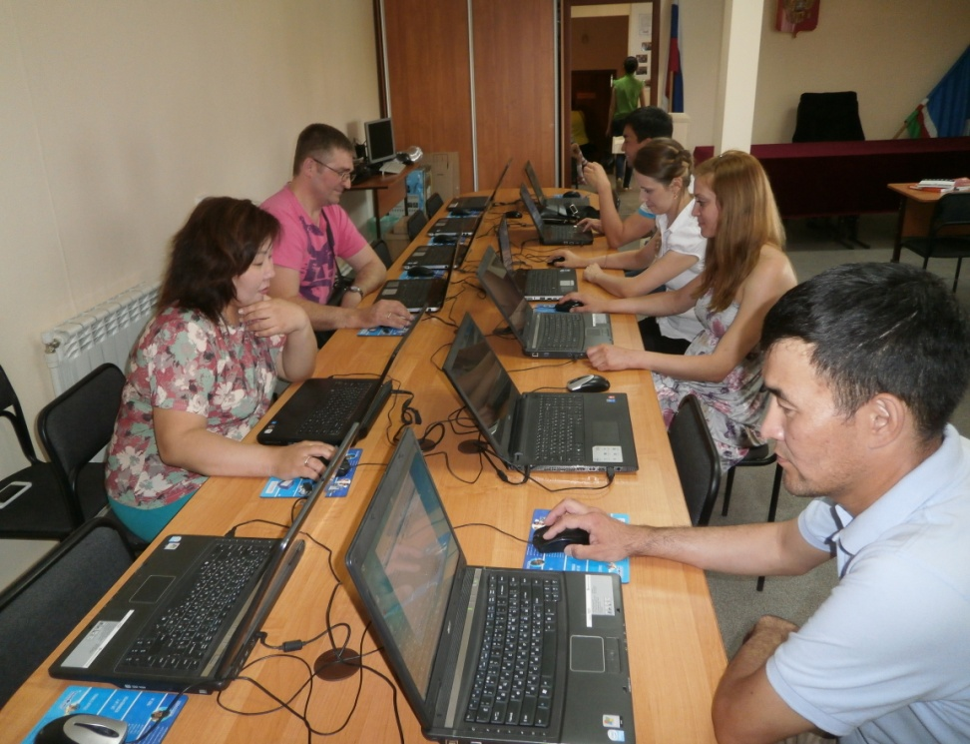
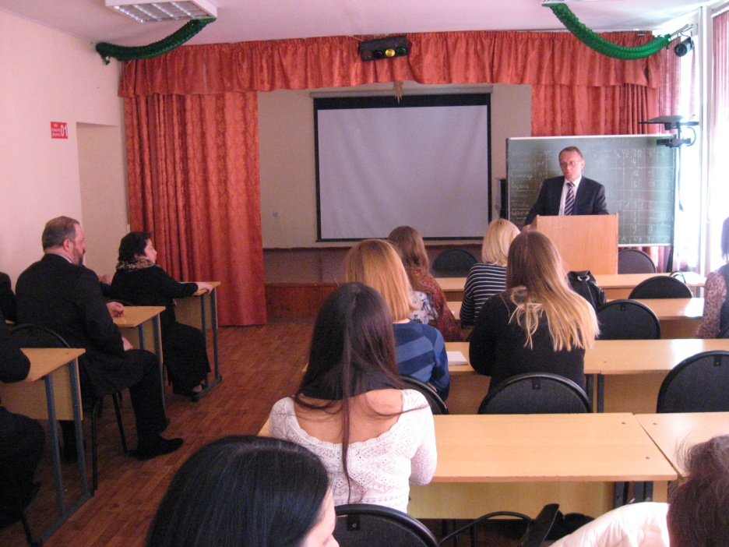
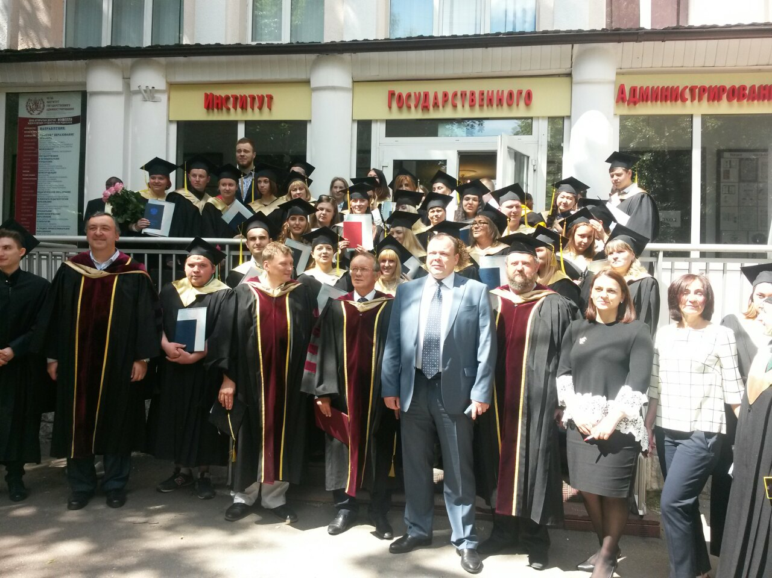

Slide 5

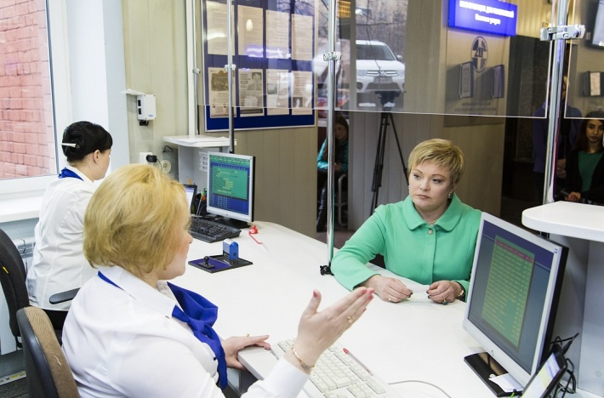
Faculty of Economics and Management
Areas of training:
Management - students learn to prepare financial statements and accurately assess the price of an enterprise’s assets, as well as how to create thoughtful business plans that make it possible to effectively develop a company, how to promote products on the market, how to generate demand and analyze customer behavior.
Economics - students receive knowledge that will allow them to competently conduct tax and accounting records in private companies and government agencies. During their studies, students study the features of financial flows in companies and understand how to manage them correctly. Graduates of the Faculty of Economics and Management are able to professionally evaluate investment projects, draw up various official documents according to all the rules, and determine the efficiency of enterprises and individual areas.
State and municipal management - students learn how to assess budget expenses and effectively plan a company’s budget, effectively create the image of a company or government structure, promote an organization in the modern market, create projects aimed at developing an enterprise, monitor and plan the work of employees, draw up different types of reports and other official documents.
Business Informatics - in 2023, enrollment has been announced for a new area of training “Business Informatics”. Students receive general theoretical training in the field of development, management and operation of information systems, automation of enterprises and production, organization of IT services. In addition to information disciplines, they study logistics, strategic management, information law, modeling and optimization of business processes, architecture of corporate information systems, etc. A professional in the field of business informatics is engaged in the development and use of information technologies in business and has knowledge in the field of computer science, economics and management.

Slide 6
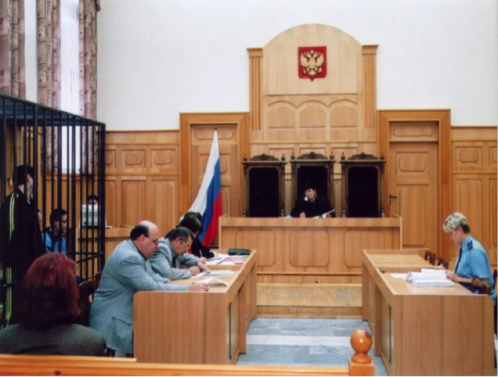
Faculty of Law
Our students undergo professional training in the following areas:
Civil law profile (bachelor's degree), Civil law, family law, private international law (master's degree) – upon completion of these profiles, our graduates work in the prosecutor’s office, law and notary offices, courts, and commercial organizations.
Criminal law profile (bachelor's degree), Theory and practice of application of criminal legislation (master's degree) - lawyers can climb the career ladder in the prosecutor's office and courts, law firms, internal affairs bodies, investigative bodies.
Training sessions with students are conducted by doctors and candidates of legal sciences. Representatives of specialized organizations and practicing lawyers also work with them. The faculty has created scientific circles where our students learn all the secrets of science, attend court hearings, expert institutions, police departments and other structures.
Our students take part in conferences at various levels. While receiving an education at the IGA, students undergo practical training in those structures where they are employed upon graduation. Our law faculty prepares specialists who will confidently move up the career ladder, work with honor and dignity, both in private companies and in government agencies.

Slide 7
Psychology and Pedagogical Faculty
Areas of training:
Psychology – the institute trains specialists in the field of psychological counseling. Future psychologists-consultants master the competencies of practical work in various organizations, accompanied by educational, educational and social activities. Psychologists solve a range of problems in the field of healthcare, economics, law, culture, sports, management, etc. Knowing the patterns of mental development, specialist psychologists are able to correct a person’s personality at all stages of his development, solve family problems, and contribute to building a professional career.
Special (defectological) education - our university prepares teaching staff to work with people with speech disorders. These are not only children with speech pathology, but also those with visual, hearing, musculoskeletal impairments, mental retardation, mental retardation, autism spectrum disorders, etc. Our students master modern technologies for correcting the speech of children and adults with various speech disorders. deviations of oral (dyslalia, aphasia, rhinolalia, dyslexia, etc.) and written speech (dysgraphia), contribute to the formation of communication skills. Graduates of speech therapists can work in educational and medical organizations, as well as conduct private practice.

Slide 8
Faculty of Psychology and Education
Psychological and pedagogical education – the program is aimed at training specialists with knowledge and skills in the field of preschool and primary school education. The main task of teachers and psychologists of educational institutions is to provide psychological and pedagogical support for children of preschool and primary school age in the modern social and educational environment, including in the conditions of inclusive education. Our graduates are able to develop programs that contribute to the formation of students' personalities, motivation to learn, increasing the level of academic performance, and the formation of a conflict-free children's team. Particular attention in the training of future specialists is paid to the creation of conditions conducive to the prevention of professional burnout of teaching staff.
Pedagogical education – the program is aimed at training specialists in the field of teaching legal disciplines in educational organizations who have current legal knowledge, as well as competencies in the field of psychology, pedagogy, teaching and educational methods. Future specialists will learn to organize an effective educational process, apply modern pedagogical technologies and diagnostic tools for learning outcomes in practice. The acquired professional competencies will allow graduates to carry out professional activities in the system of general and additional education, institutions of secondary vocational education, educational authorities, and legal departments of enterprises.

Slide 9
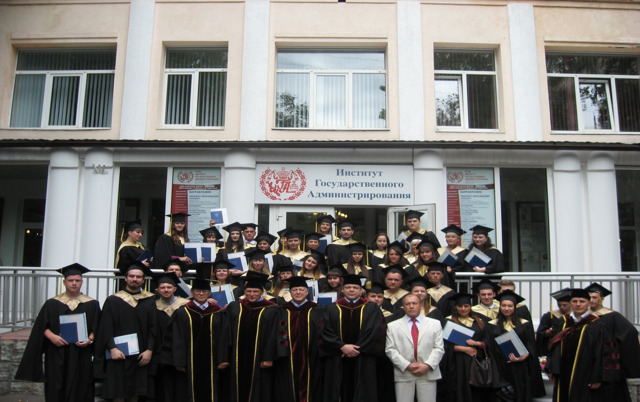
Our graduates, having graduated from the Institute of the State Administration, can find work both in government agencies and in private companies, organizations, and structures. For example, specialists are in demand in kindergartens, schools, hospitals, health centers, and lyceums. They are often invited to work in private educational institutions and are offered decent salaries. After graduation, you can continue your studies in a master's program. Graduates also work in advertising firms, various financial institutions and state and municipal organizations.

